Slide 1
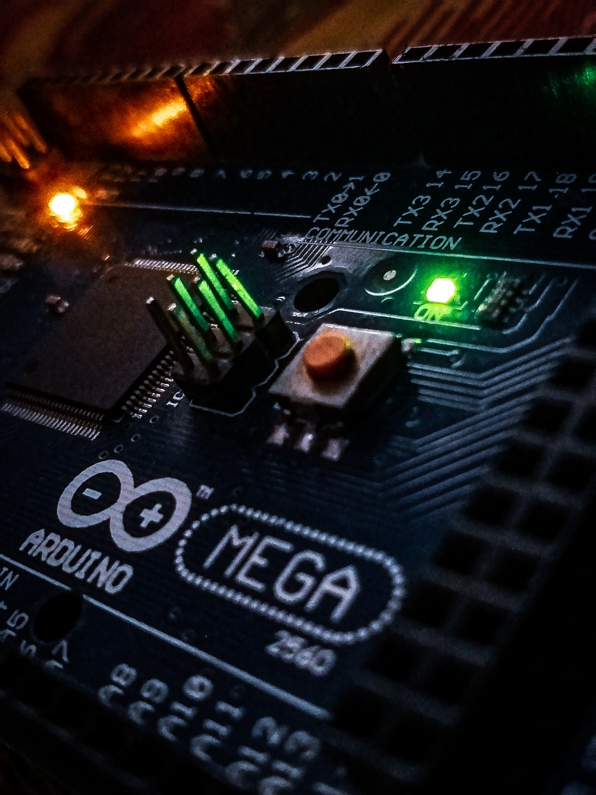
Air pollution detection with Arduino and CCS811 sensor
CSE 3200
Submitted from:
Ishrat Zahan Tani
Roll No. 1803128
Dept. Of CSE,RUET
Submitted to:
Md. Farukuzzaman Faruk
Assistant Professor
Dept. Of CSE,RUET

Slide 2
Questions that may arise about the project
What is the purpose of this project?
What is the work done by this project?
How it is implemented?
Why should it be taken under consideration?
How can we be benefitted by this project?

Slide 3
What is the purpose of this project?
To help people to take necessary steps from polluted air

Slide 4
What is the work done by the project?
Measure CO2 and TVOC from the air
CO2 : Carbon dioxide
TVOC : Total Volatile Organic Compound . Example: benzene, ethylene glycol, formaldehyde, methylene chloride, tetrachloroethylene, toluene, xylene, and 1,3-butadiene.

Slide 5
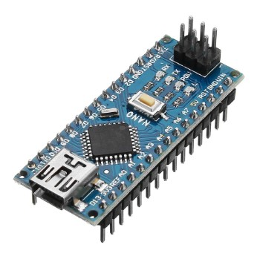
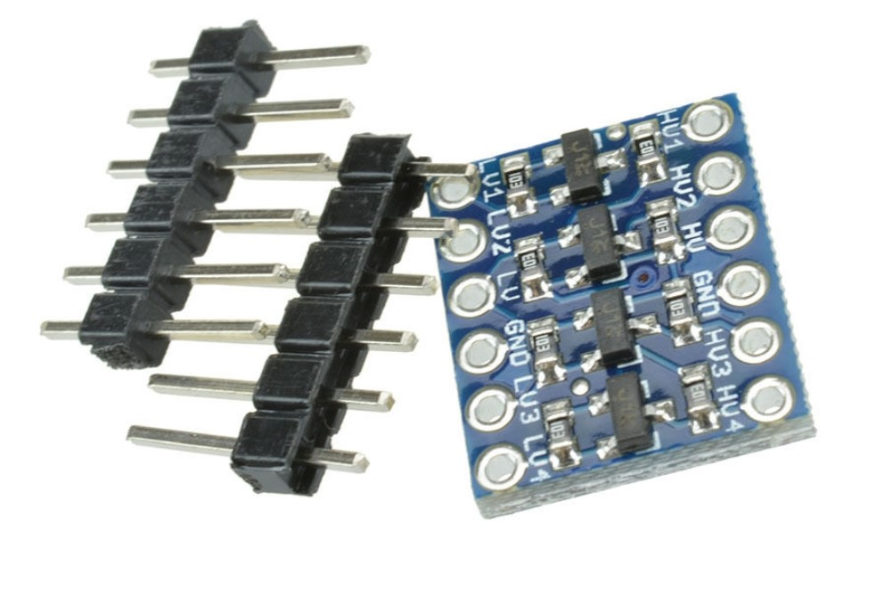
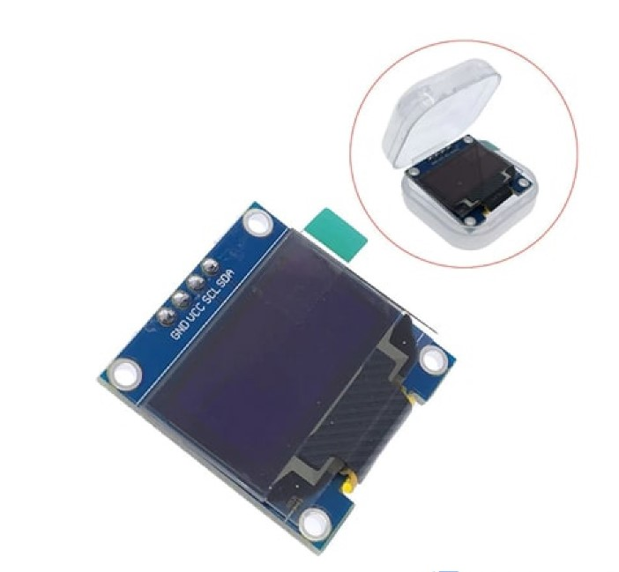
How the project is implemented?
Hardware Instruments
Arduino Nano
IIC I2C Logic Level Converter Bi-Directional Module 5V to 3.3V For Arduino
0.96" Inch I2C OLED Display

Slide 6
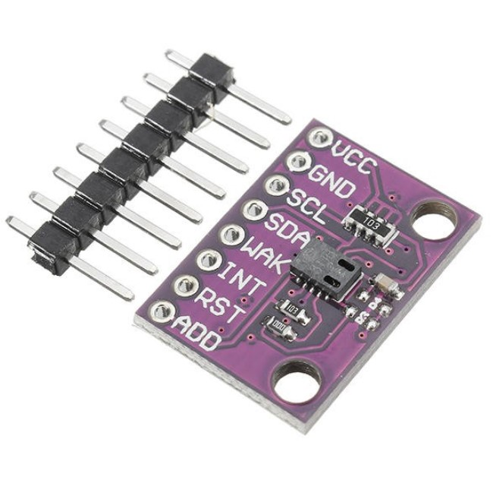
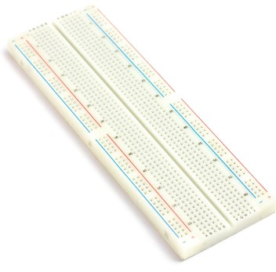
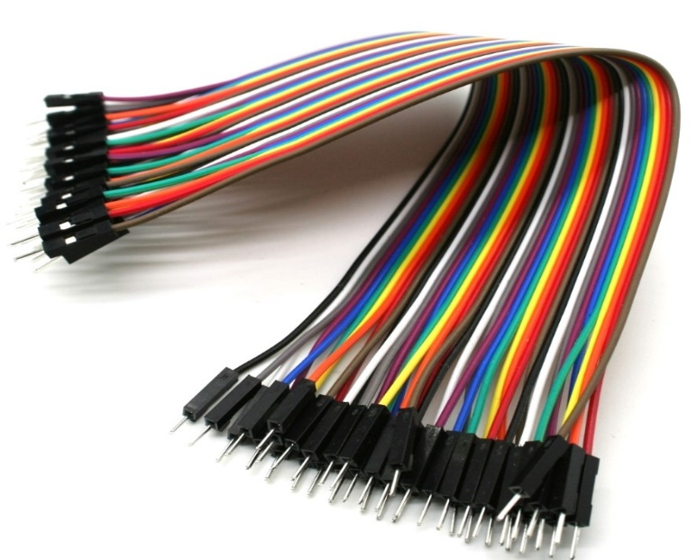
How the project is implemented?
Hardware Instruments
Air Quality Breakout - CCS811
Breadboard
Connecting Wires :
Male to male jumper wires

Slide 7
How the project is implemented?
Software/Languages for implementing this project
Arduino IDE
C++

Slide 8
How the project is implemented?
Arduino Nano
Converter
Main code is loaded here
Microcontroller
Contains analog and digital pins
Converts 5V to 3.3 V for Arduino and vice versa

Slide 9
How the project is implemented?
CCS811
LED Display
Air Quality Breakout Sensor
Shows the measured Carbon Dioxide and TVOC and display it in LED
Shows the measured Carbon Dioxide and TVOC and display it in LED
Measures the Carbon Dioxide and TVOC from air
VCC, GND,SCL,SDA,WAK these five pins are used in connection
Contains four pins VCC,GND,SDA,DCL and these are used in connection

Slide 10
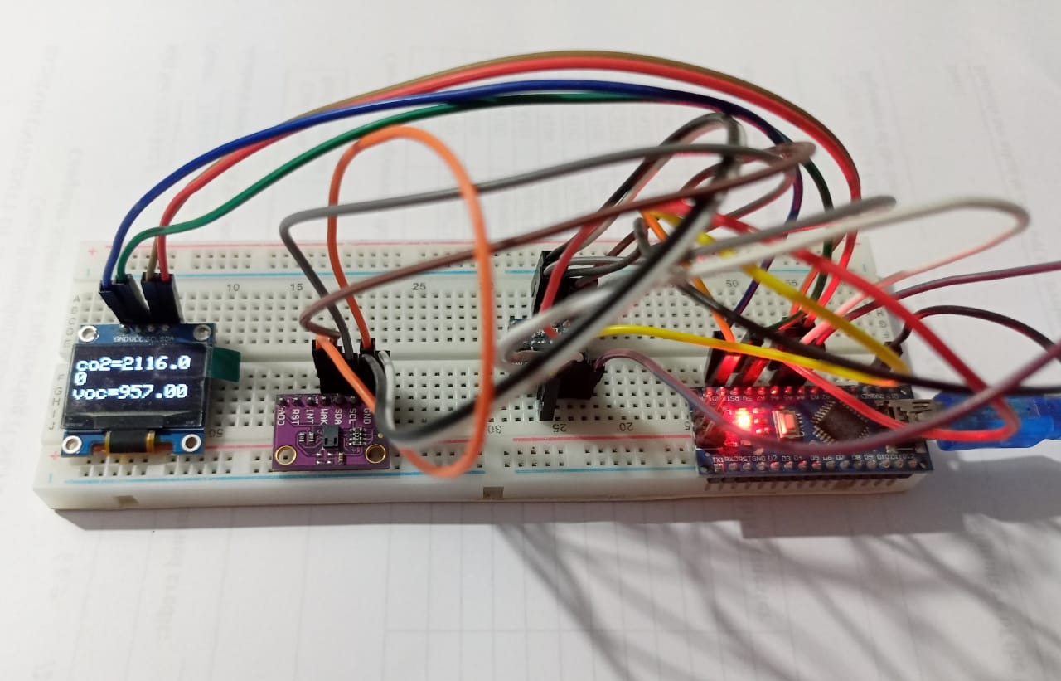
Project Set Up

Slide 11
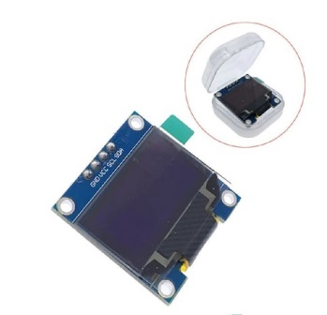
Pin Connection
LED Display
Arduino Nano
GND
GND
VCC
5V
SCL
A5
SDA
A4

Slide 12

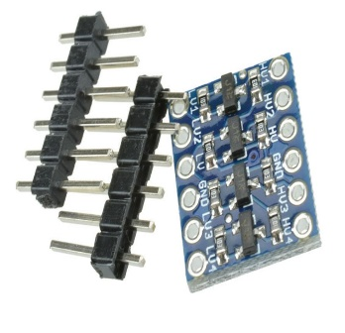
Pin Connection
CCS811
Converter
GND+WAK
GND
SDA
LV1
SCL
LV2
VCC
LV

Slide 13
Pin Connection
Converter
Arduino Nano
HV1
A4
HV2
A5
HV
5V
GND
GND

Slide 14
Why should it be taken under consideration?
Air Pollution in Bangladesh
Air pollution through faulty vehicles
Amount of dust in the air in Bangladesh
Emission of large amount of Carbon dioxide

Slide 15
How can we be benefitted by this project?
Will be helpful for asthma patient
Can warn users to take necessary steps such as wearing mask, opening window of room etc.
Portable Device
Can be used in home, car in smart-watch

Slide 16
Thank You

